Slide 1
Secret Sharing Protocols
-Publicly Verifiable Secret Sharing with applications
Christopher Foley

Slide 2
Outline
History
General Model
Publicly Verifiable Secret Sharing
Applications

Slide 3
Disclaimer
Lots of things in this fields
Originally wanted to work with Stinson and Wei’s paper
Then Stadler
Then Gan, et al.
Then Wu & Tseng
If I had 2 more weeks then I’d probably do Jeppsen & Lemming (Voting) or probably Chen, et al. (Executing wills online)

Slide 4
History
1979 – basic secret sharing schemes proposed
  Assumed all participants honest
1987 – Feldman proposed first Verifiable secret sharing (VSS)
  Allowed participants to verify their shares but not others
1996 – Stadler introduced first Publicly Verifiable Secret Sharing (PVSS)
  Verify shares held by any participant without revealing own shares

Slide 5
History
Elliptic Curves
  Weil pairing in 1993
  Joux – identity based encryption, signature algorithm (2000)
Pairing Based cryptography
  Signatures (2002)
  Key agreement protocols (2002)
  Signcryption algorithms (2005)

Slide 6
General Model of PVSS
Three Phases
  Initialization phase
  Distribution Phase
  Reconstruction Phase

Slide 7
General Model of PVSS
Initialization Phase
  All public parameters, private and public keys generated
  Dealer and Participants Identified

Slide 8
General Model of PVSS
Distribution Phase
  Distribution of the shares: Dealer uses participants public keys and public parameters to compute values and the share of the secret to the participants
  Verification of the shares: Any share may be verified by any party. If all shares are verified then the parties believe that the shares contain the secret and the dealer is uncorrupted. If any share fails, the dealer is corrupted and the scheme aborts.

Slide 9
General Model of PVSS
Reconstruction:
  Decryption of shares: participants use private key to decrypt share
  Reconstruct secret: The secret may be reconstructed from some of the participants.

Slide 10
Pairing-Based PVSS
{U₁,U₂,…,U_{n}} are participants
The Dealer, D, wishes to distribute a secret to the participants

Slide 11
Pairing-Based PVSS
Initialization Phase
The key generation system generates the public parameters Param={G₁,G₂,q,c,P,P_{pub},H}
Each participant chooses a private key α_{i} ∈ ℤ_{q} and computes the Public key P_{i}=α∙P_{pub} for i=1..n

Slide 12
Pairing-Based PVSS
Distribution Phase
(Decryption of the shares)
The dealer chooses a random polynomial
Of degree t-1 with coefficients in ℤ_{q}

Slide 13
Pairing-Based PVSS
Distribution Phase
(Decryption of the shares)
The dealer selects random numbers r_{i} ∈ ℤ_{q}
The dealer then computes C_{j}=c_{j}∙P, X_{i}=f(i)∙P, Y_{i}=c(P_{i},P_{pub})^{f(i)}, α_{i}=r_{i}∙P, β_{i}=r_{i}∙P_{i}, h_{i}=H(P_{i},X_{i},Y_{i,} α_{i} , β_{i}), γ_{i}=(r_{i}+h_{i}∙f(i))∙P_{pub} for j=0,1,..,t-1 and i=1..n

Slide 14
Pairing-Based PVSS
Distribution Phase
(Decryption of the shares)
The dealer then publishes all C_{j} and σ_{i}=(Y_{i,},α_{i}, β_{i}, γ_{i}) to all participants.
Note: each X_{i} can be reconstructed from:

Slide 15
Pairing-Based PVSS
Distribution Phase
Verification of the shares
Participants recover then checks two equations:
and

Slide 16
Pairing-Based PVSS
Distribution Phase
Verification of the shares
If these checks do not fail, the participants may assume that the shares distributed by the dealer are uncorrupted.

Slide 17
Pairing-Based PVSS
Reconstruction Phase
Decryption of shares:
Each participant uses their private key to decrypt their share

Slide 18
Pairing-Based PVSS
Reconstruction Phase
Interpolation
Any t shareholders U_{i} with shares S_{i} may join to reconstruct the secret

Slide 19
Applications Overview
PVSS has had numerous applications discussed in literature
  Key/Code Escrow systems
  Commerce
    Anonymous cash exchange
  Signature authentication
  Revocable authority
  Electronic voting
  Authentication of Last Will and Testament

Slide 20
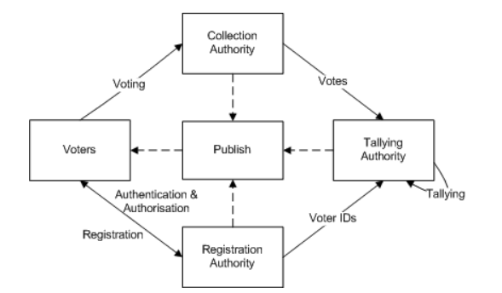
Applications - Electronic Voting
Secure
Anonymous
Verifiable
S. Jepsen, K. Lemming. Electronic Voting Application Based on Public Verifiable Secret Sharing. Masters Thesis, Department of Mathematics, Aalborg University, 2016

Slide 21
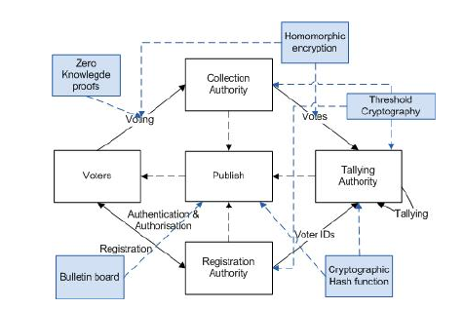
Applications – Electronic Voting
S. Jepsen, K. Lemming. Electronic Voting Application Based on Public Verifiable Secret Sharing. Masters Thesis, Department of Mathematics, Aalborg University, 2016

Slide 22

Applications – Electronic Wills
Electronically Sealed wills
Publicly verifiable
  Probate Court
  Testator/ix
  Heirs
Self proving
Revocable

Slide 23
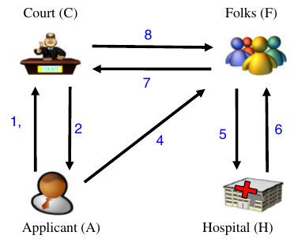
Applications – Electronic Wills
Applicant creates registry
Court approves registry
Applicant sends share to court
Applicant distributes shares
After death heirs get certificate
Death certificate
Shares and certificate to court
Will reconstructed.
3

Slide 24
Applications
PVSS is a growing field with opportunities.
PVSS has a number of applications being developed (2011) including:
  Key Software Escrow
  Electronic Cash

Slide 25
References
M. Nojoumian, Lecture Notes, COT6427 Secret Sharing Protocols, Florida Atlantic University, Spring 2018
B.Chor, S. Goldwasser, S. Micali, B. Awerbuch. Verifiable Secret Sharing and Achieving Simultaneity in the Presence of Faults. Proceedings of the 26th IEEE Symposium on the Foundations of Computer Science (FOCS), pp. 383-395, 1985
M. Stadler. Publicly Verifiable Secret Sharing. U. Mauer(Ed.) Advances in Cryptography – EUROCRYPT ‘96, LNCS 1070,
S. Jepsen, K. Lemming. Electronic Voting Application Based on Public Verifiable Secret Sharing. Masters Thesis, Department of Mathematics, Aalborg University, 2016
T. Wu, Y. TSENG. A Pairing-Based Publicly Verifiable Secret Sharing Scheme, Journal of Systems Science & Complexity, Feb 2011 24:186-194
Anna Nicole Smith image by Toby Forage - Flickr, CC BY-SA 2.0, https://commons.wikimedia.org/w/index.php?curid=1659458

